Slide 1


Dario Sammaruga
31/12/2022

Slide 2

Outline
Executive Summary
Introduction
Methodology
Results
Conclusion
Appendix

Slide 3
Executive Summary
Summary of methodologies
Data Collection using SpaceX API and web scraping from Wikipedia
Exploratory Data Analysis (EDA) with data visualization and Dashboard
Machine Learning
Summary of all results
Data collection has been possible using free sources
EDA allowed to detect best feature to predict successful launches
Good predictions reached, so we can discuss about insights

Slide 4
Introduction
SpaceX has been the first company capable to reuse first stage of rockets and this means less costs for every launch
The target of the project is to investigate the possibility for SpaceY to enter in the space company market in competition with SpaceX
To do it we need to:
Estimate total costs for launches after predicting successful landings for the first stage of SpaceX rockets
Understand if there are some launch sites that has better performance than others

Slide 5

Section 1

Slide 6
Methodology
Executive Summary
Data collection methodology:
Data collected with SpaceX API
Web Scraping from Wikipedia (https://en.wikipedia.org/wiki/List_of_Falcon_9_and_Falcon_Heavy_launches)
Perform data wrangling
Data has been enriched after One Hot Encoding process and after creating a binary outcome label based on outcome categories provided.
Perform exploratory data analysis (EDA) using visualization and SQL
Data has been queried and displayed in charts to select which feature should be used for predictive analysis and to understand first basic insights.

Slide 7
Methodology
Executive Summary
Perform interactive visual analytics using Folium and Plotly Dash
Displaying Launch sites and distance from infrastructures like railways, highway, cities and coastline on a map has been possible to understand why some sites had less launches than others.
An interactive dashboard has been proposed to drill-down on data.
Perform predictive analysis using classification models
Data has been normalized, then splitted in training and test datasets.
Four classification models has been evaluated on datasets.
Every model has been optimized with different combinations of parameters and finally I compared accuracy for each optimized model.

Slide 8
Data Collection
Data has been collected with two methods:
SpaceX API (https://api.spacexdata.com/v4/rockets)
Web Scraping from Wikipedia (https://en.wikipedia.org/wiki/List_of_Falcon_9_and_Falcon_Heavy_launches)

Slide 9
Data Collection – SpaceX API
We get data from SpaceX REST API using four endpoints:
https://api.spacexdata.com/v4/rockets/
https://api.spacexdata.com/v4/launchpads/
https://api.spacexdata.com/v4/payloads/
https://api.spacexdata.com/v4/cores/
GITHUB URL:
https://github.com/BeanRepo/IBM-Data-Science-Capstone-Project/blob/main/week%201/jupyter-labs-spacex-data-collection-api.ipynb
Get data with requests through API
Filter data to select only Falcon 9 launches
Deal with missing values

Slide 10
Data Collection - Scraping
Source code of Wikipedia website has been extracted to collect data in a table.
https://en.wikipedia.org/wiki/List_of_Falcon_9_and_Falcon_Heavy_launches
GITHUB URL:
https://github.com/BeanRepo/IBM-Data-Science-Capstone-Project/blob/main/week%201/jupyter-labs-webscraping.ipynb
GET request content of Wikipedia page
Extract column names from HTML table headers
Parse HTML table to insert clean data on a Dataframe

Slide 11
Data Wrangling
Exploratory Data Analysis has been performed to understand:
KPI about launches, landing sites, success rate, payload wheight
Relationships between features
Querying, Summarization, one-hot encoding processes has been done
Landing Outcome binary label for classification has been created
EDA
Querying and Summarization
Landing Outcome Label Creation

Slide 12
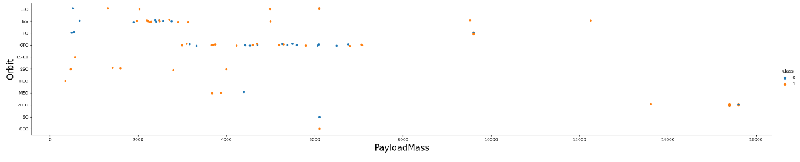
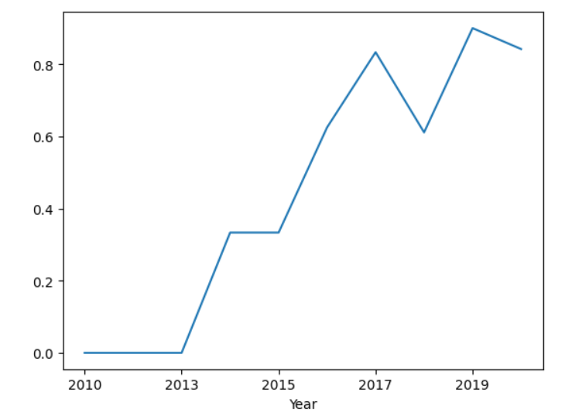
EDA with Data Visualization
To better understand data, some scatter plots and bar plots has been created to understand relationship with couples of features:
Payload Mass and Flight Number
Launch Site and Flight Number
Launch Site and Payload Mass
Orbit and Flight Number
Orbit and success rate
Payload and Orbit
Success Rate trend over time
GITHUB URL:
https://github.com/BeanRepo/IBM-Data-Science-Capstone-Project/blob/main/week%202/jupyter-labs-eda-dataviz.ipynb

Slide 13
EDA with SQL
SQL queries performed
how many launches came from launch sites,
average payload for every launch,
first successful landing date,
successful landings on ship,
Total number of successful and failure missions
Booster version with max payload carried
Resume of missions in 2015 by month
Landing outcomes between 04-06-2010 and 20-03-2017
GITHUB URL:
https://github.com/BeanRepo/IBM-Data-Science-Capstone-Project/blob/main/week%202/jupyter-labs-eda-sql-coursera_sqllite.ipynb

Slide 14
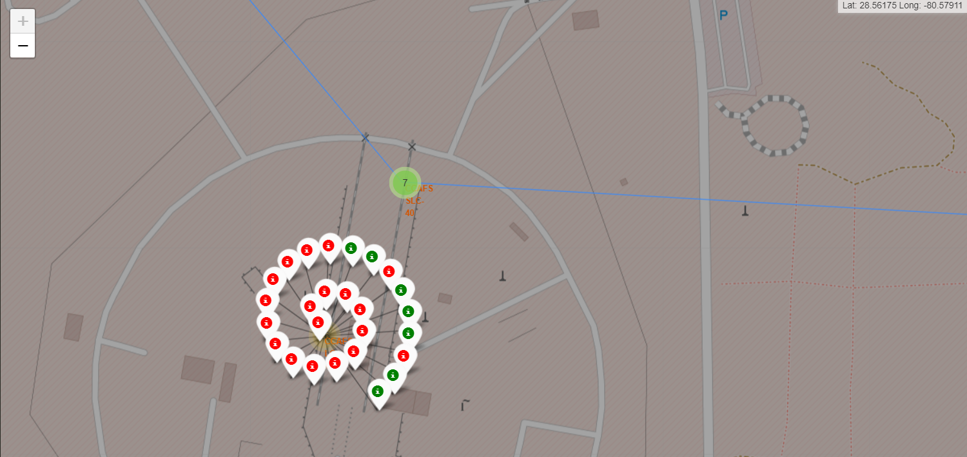
Build an Interactive Map with Folium
markers, circles, lines has been added to a folium map, where:
Markers are displayed as launch sites
Circles are displayed as areas around launch sites
Marker clusters display binary landing outcomes for each launch site
Lines has been plotted between a launch site and 2 coordinates: closest seashore and closest railway
GITHUB URL:
https://github.com/BeanRepo/IBM-Data-Science-Capstone-Project/blob/main/week%203/lab_jupyter_launch_site_location.ipynb

Slide 15
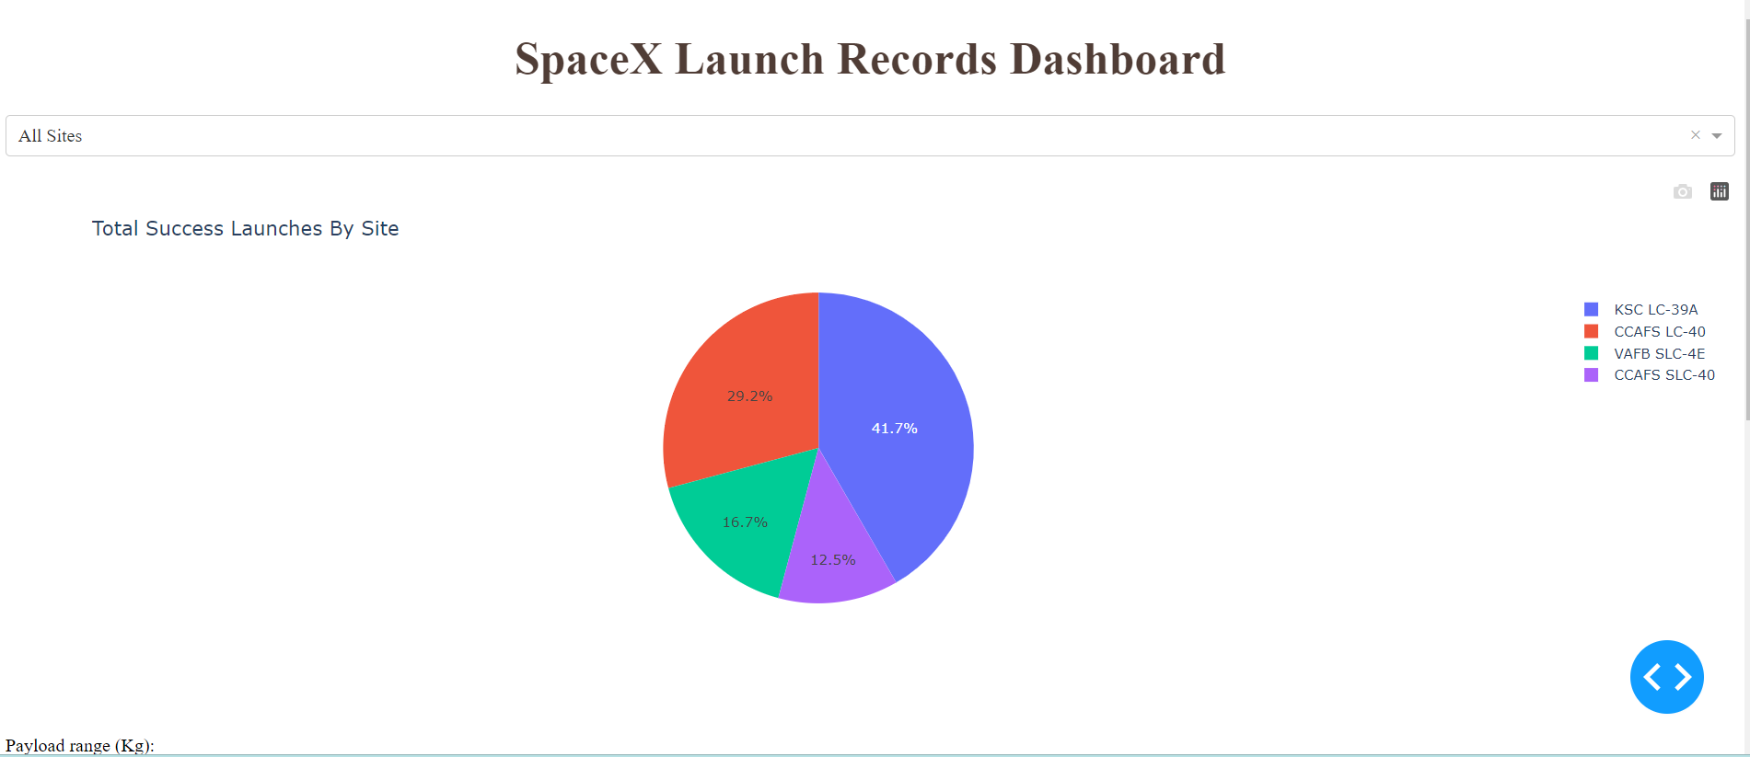
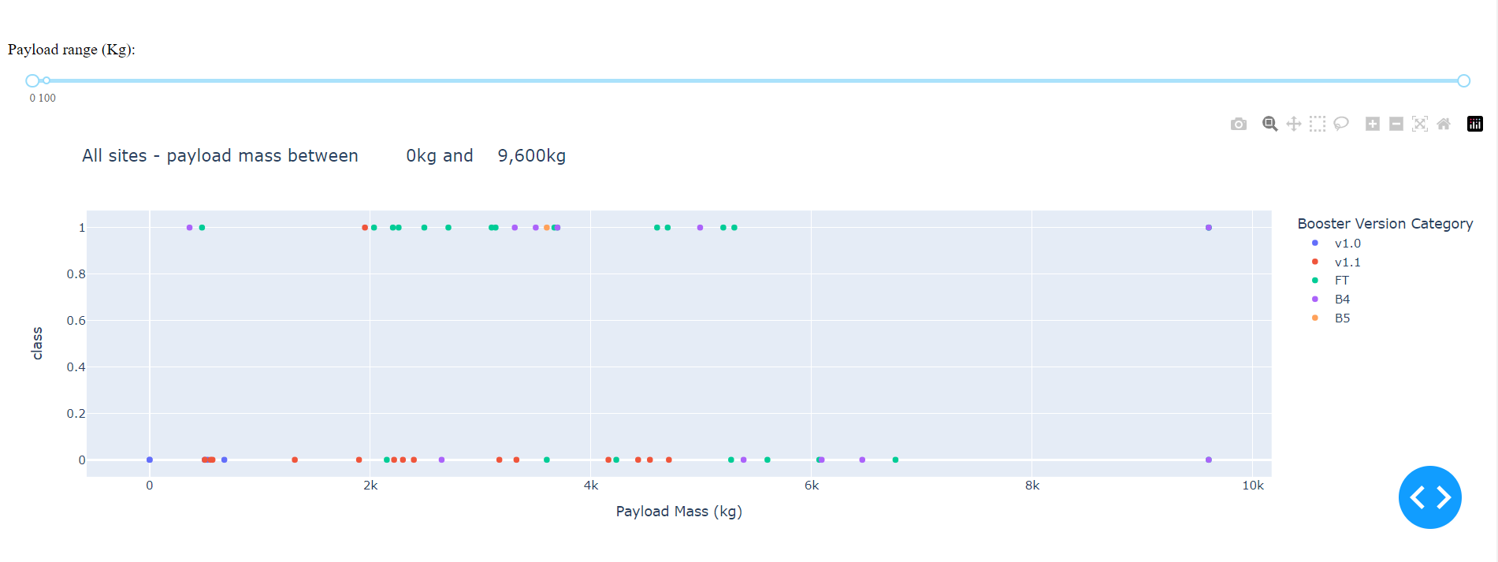
Build a Dashboard with Plotly Dash
Two graphs are displayed in order to visualize:
Percentage of launches by site
Payload range
Investigating relationships between payloads and launch sites has been fundamental to understand the best launch site based on payloads.
GITHUB URL:
https://github.com/BeanRepo/IBM-Data-Science-Capstone-Project/blob/main/week%203/lab_dash_app.py

Slide 16
Predictive Analysis (Classification)
Has been performed a Data normalization and the dataset has been splitted in Train and Test sets.
4 Classification Methods has been deployed:
Logistic regression
Support Vector machines (SVM)
Decision Tree Classifier
K-Nearest-neighbour (KNN)
For every model a different dictionary of parameters has been used to find the best ones using Grid-Search Cross validation and accuracy scores has been calculated on train and test sets
GITHUB URL: https://github.com/BeanRepo/IBM-Data-Science-Capstone-Project/blob/main/week%204/SpaceX_Machine%20Learning%20Prediction_Part_5.ipynb
Data normalization and sampling
Train and test models with Grid Search Cross Validation
Comparison of optimized models

Slide 17
Results
Exploratory data analysis results
Space x uses four launch sites
The first launch has been done by SpaceX and NASA
Average payload of F9 x1.1 booster is 2928 kg
The first successful landing has been in 2015 after five years of launches
Almost every mission reached his target. This is a different concept compared to landing outcome
Many booster version has successful landing outcome on drone ship with an above average payload
Only two booster versions failed at landing on drone ship in 2015
The success rate on landing increases after time

Slide 18
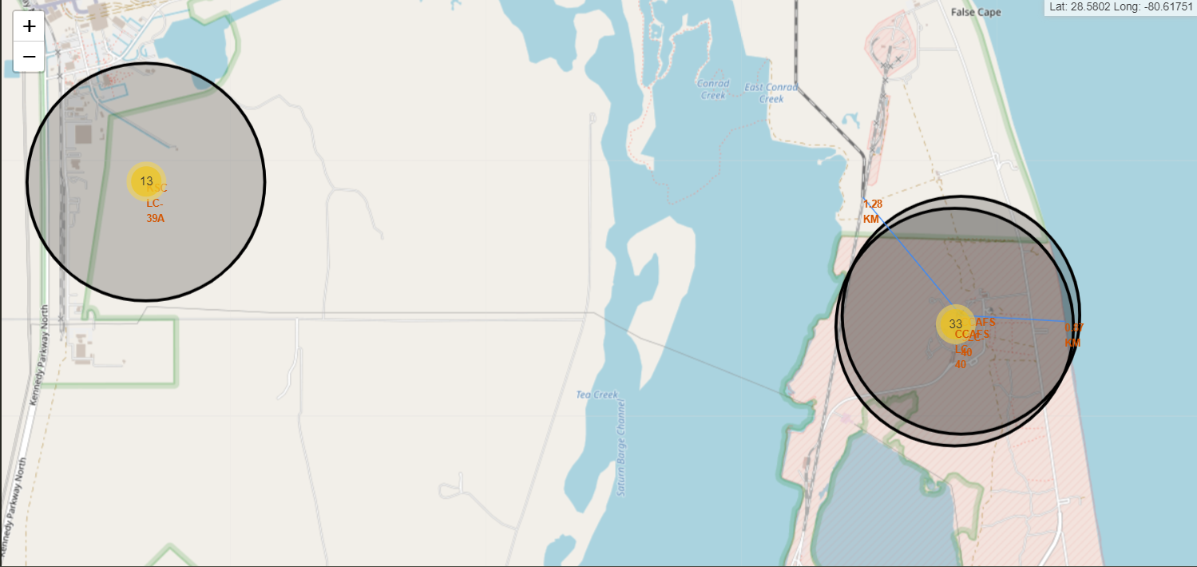
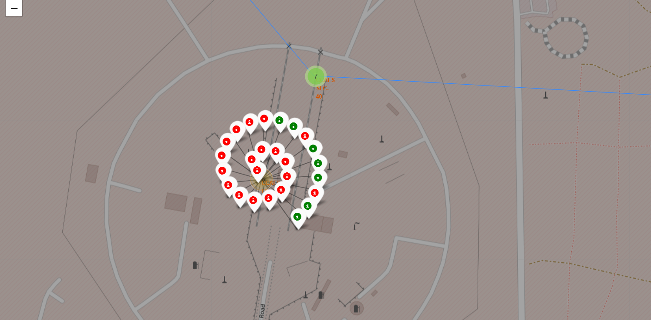
Results
Interactive analytics

Slide 19
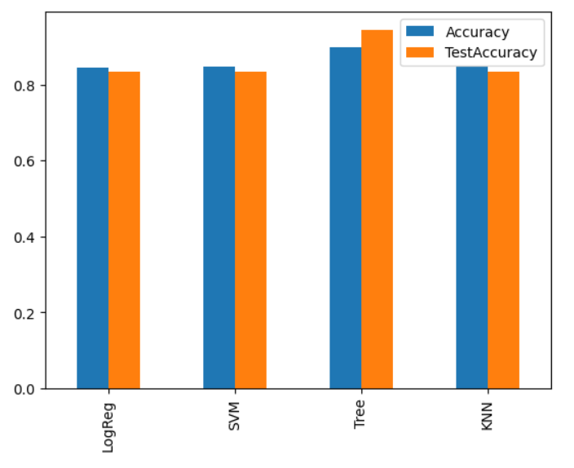
Results
Predictive analysis results
Decision tree classifier is the best model deployed
Train accuracy over 87%
Test accuracy over 94%

Slide 20

Section 2

Slide 21
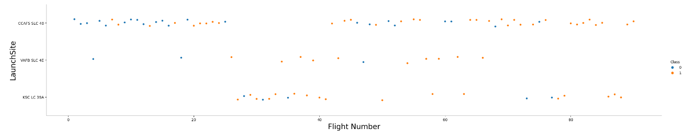
Flight Number vs. Launch Site
The best Launch site is CCAF5 SLC 40
The second one is VAFB SLC 4E
Orange dots represents successful landings and is it clear that success rate increases over time

Slide 22
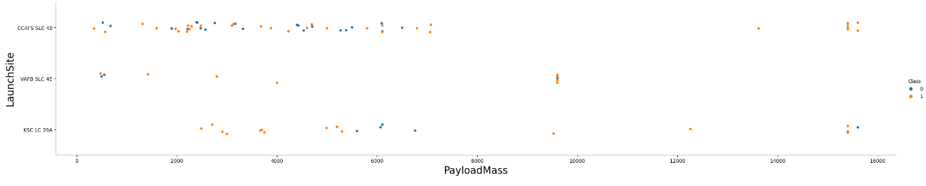
Payload vs. Launch Site
Payload over 9000kg has success rate better than lower than 9000kg of payload launches but are less in number
Payloads over 12000kg has been launched only on KSC LC 39A and on CCAFS SLC 40

Slide 23
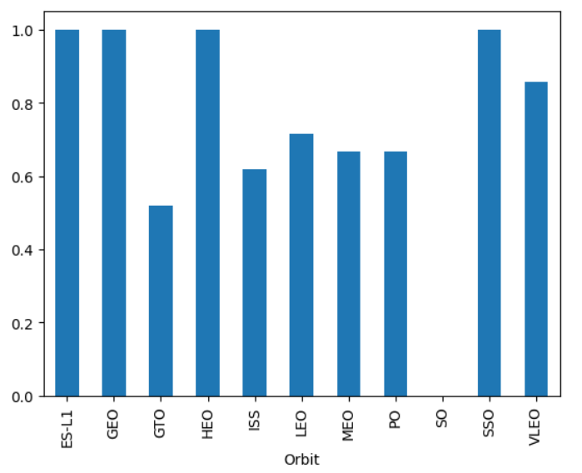
Success Rate vs. Orbit Type
Best success rates has been reached on:
ESL-1
GEO
HEO
SSO
Also VLEO and LEO has high success rate, over 70%

Slide 24
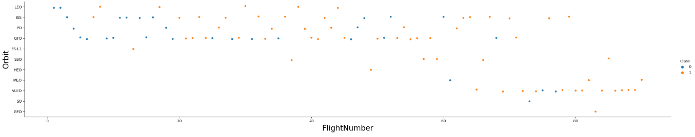
Flight Number vs. Orbit Type
Success rate increases over time on all orbits
VLEO orbit attempts are more recent. Is this a new opportunity or a more difficult orbit to reach that has been tested later due to its difficulty?

Slide 25
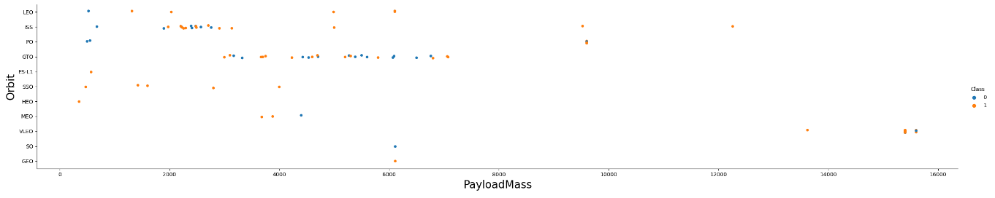
Payload vs. Orbit Type
ISS obit has a wide range of payload launched and an overall good success rate
No relation between payload and success rate on GTO orbit
Too Few launches to orbits SO and GEO, is it not a business opportunity or a new one?

Slide 26
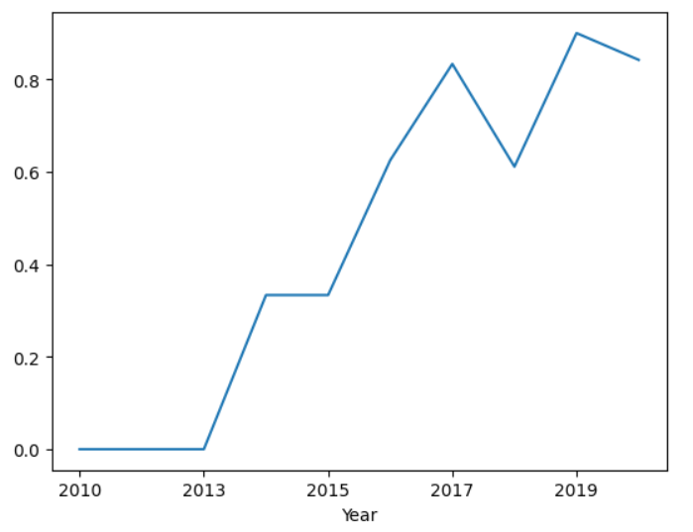
Launch Success Yearly Trend
Success rate increases over time
First successes comes after 2013
Three years needed before first successful attempt

Slide 27
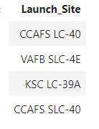
All Launch Site Names
Here the only four Launch sites used by SpaceX
Calculated as distinct values of Launch Site field on the table

Slide 28
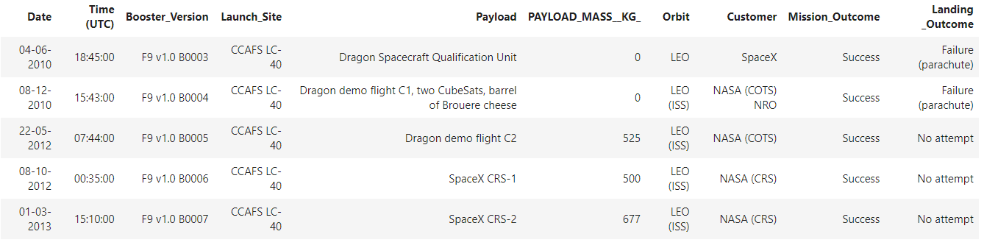
Launch Site Names Begin with 'CCA'
Find 5 records where launch sites begin with `CCA`
Selecting top 5 records on the table where Launch Sites are located at Cape Canaveral

Slide 29
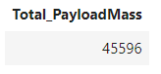
Total Payload Mass
total payload carried by boosters from NASA
Sum of Payload Mass Kg where Customer is like NASA (CRS)

Slide 30
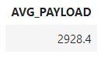
Average Payload Mass by F9 v1.1
average payload mass carried by booster version F9 v1.1
Calculating average of Payload Mass Kg field only where booster version is F9 v1.1

Slide 31
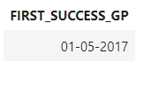
First Successful Ground Landing Date
Find the dates of the first successful landing outcome on ground pad
Selecting minimum value of date from table where Landing Outcome is Success on Ground Pad

Slide 32
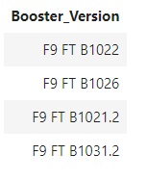
Successful Drone Ship Landing with Payload between 4000 and 6000
List the names of boosters which have successfully landed on drone ship and had payload mass greater than 4000 but less than 6000
Selecting distinct values of Booster version field where payload mass is between 4000 and 6000 and where Landing Outcome is Successful on drone ship

Slide 33
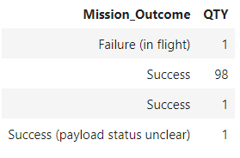
Total Number of Successful and Failure Mission Outcomes
Calculate the total number of successful and failure mission outcomes
Count of Mission Outcomes grouped by distinct Mission Outcome

Slide 34
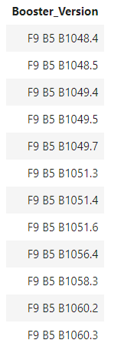
Boosters Carried Maximum Payload
List the names of the booster which have carried the maximum payload mass
Selecting distinct Booster versions with maximum payload mass on the table

Slide 35
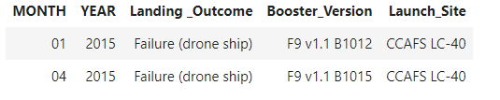
2015 Launch Records
List the failed landing_outcomes in drone ship, their booster versions, and launch site names for in year 2015
Selecting landing outcomes, booster versions and launch site for year 2015 by month only where Landing Outcome is Failure on Drone Ship

Slide 36
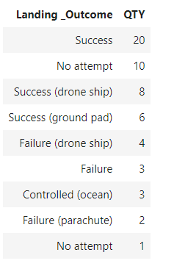
Rank Landing Outcomes Between 2010-06-04 and 2017-03-20
Rank the count of landing outcomes (such as Failure (drone ship) or Success (ground pad)) between the date 2010-06-04 and 2017-03-20, in descending order
Count of distinct Landing outcomes where date is between 2010-06-04 and 2017-03-20 and ordered by quantity in descending order

Slide 37

Section 3

Slide 38
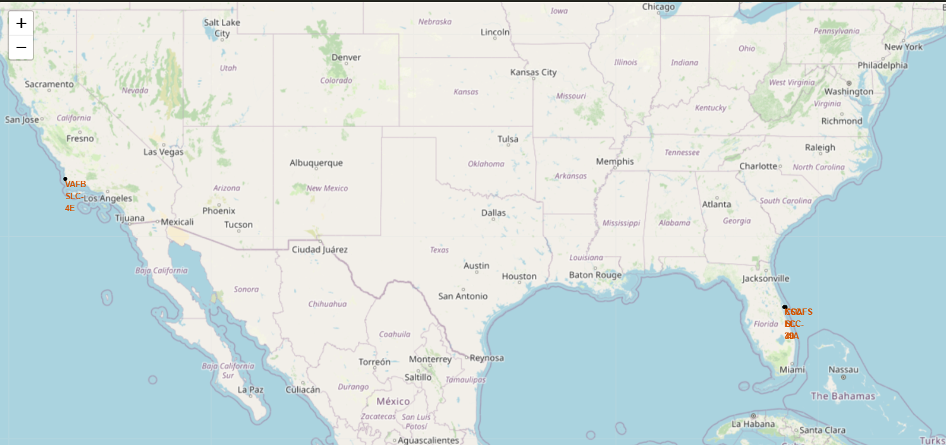
SpaceX Launch Sites
Launch sites are on seashores for safety reason and they are also close to infrastructures like railways and highways to allow supply chain close connections

Slide 39
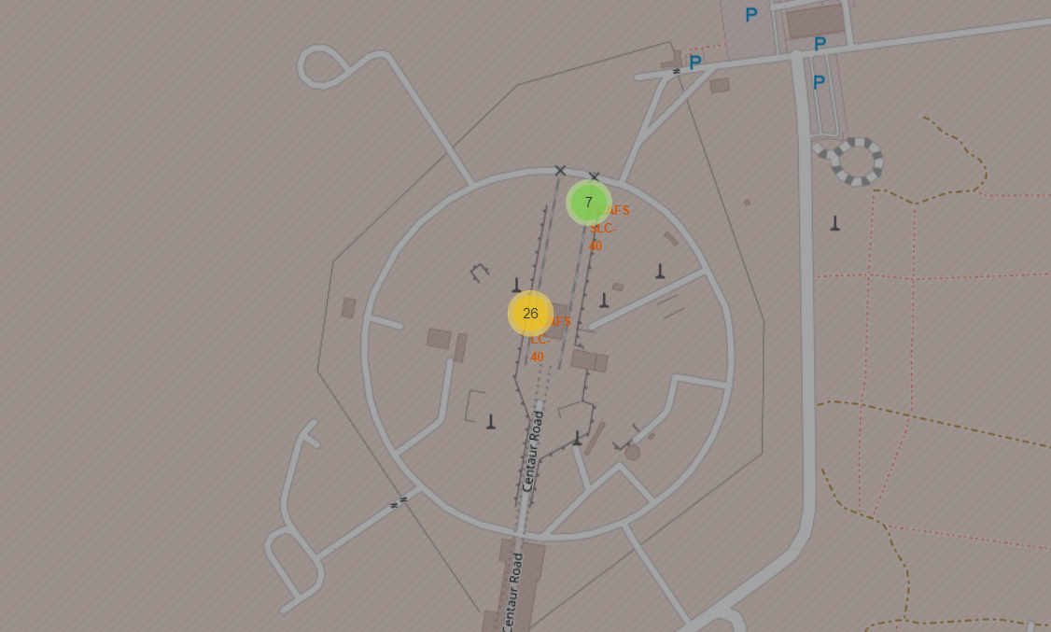
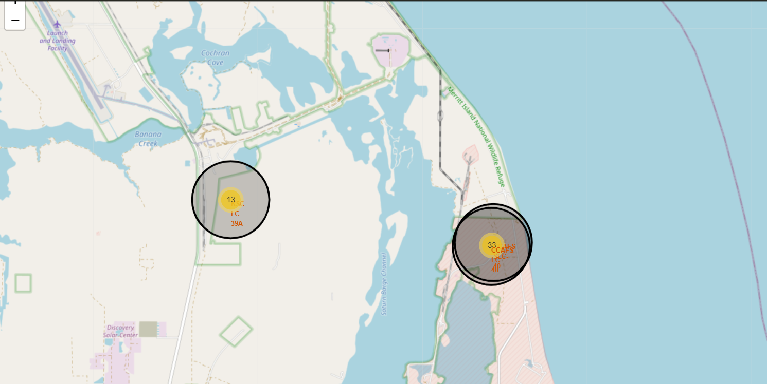

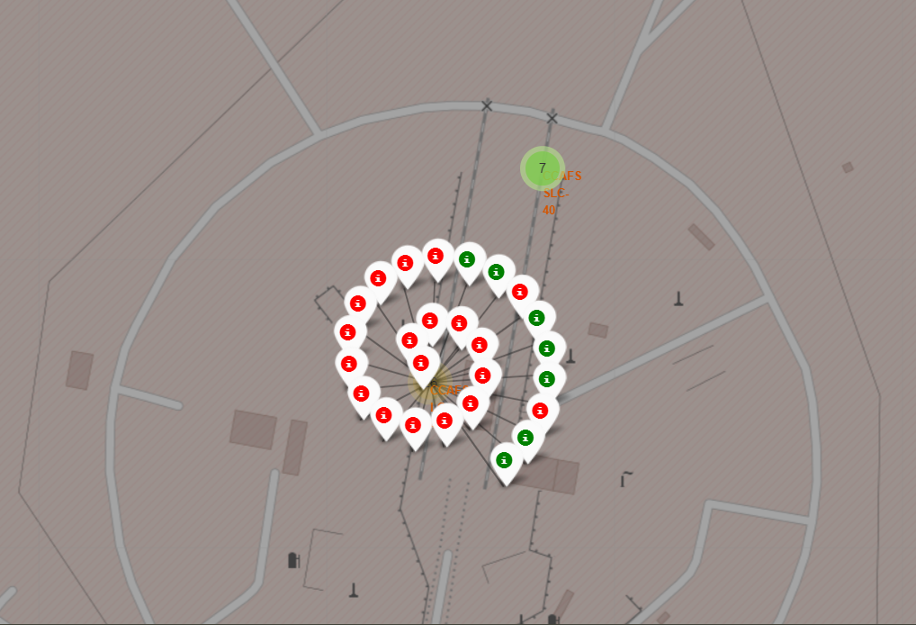
Launch Outcomes by Launch Site
Zooming on a launch site we can click on it
Then we visualize successful attempts in green and failures in red

Slide 40
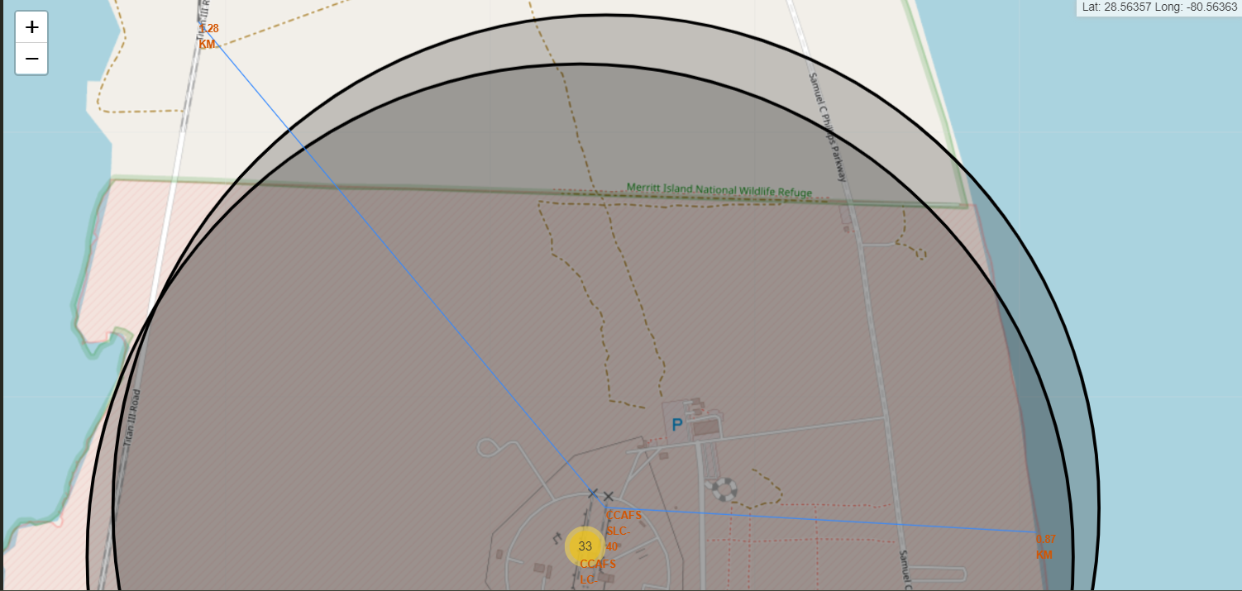
Safety and infrastructures
CCAFS SLC 40 launch site:
is 0.87Km far from the seashore
is only 1.28Km far from railways
is far from the first high density city

Slide 41

Section 4

Slide 42
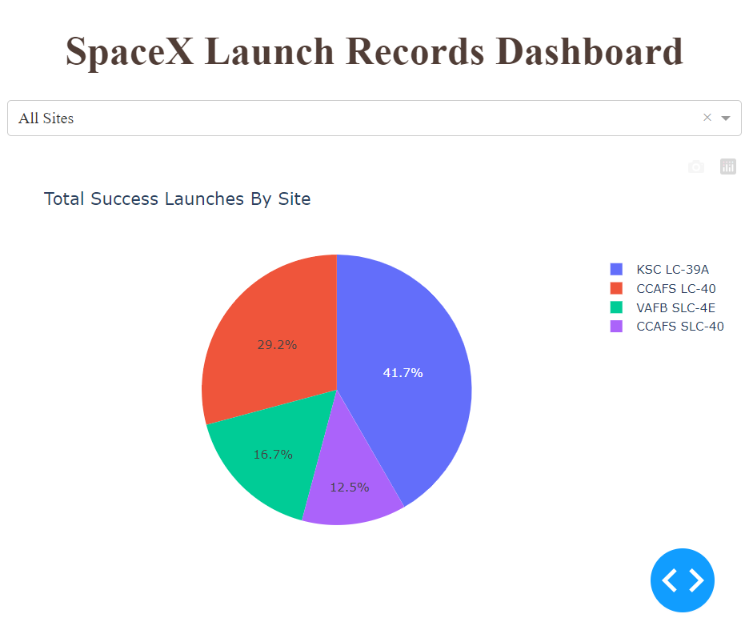
Successful Launches by sites
Most successful launches comes from Cape Canaveral

Slide 43
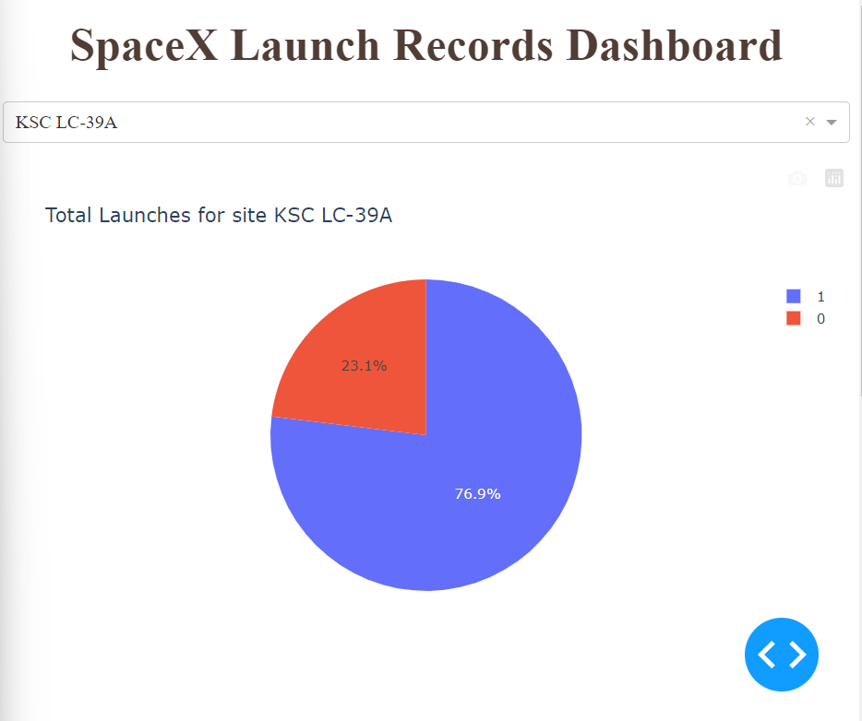
Success Rate for a Launch site
Drilling down to KSC LC-39A we discover that it has the best Success Rate

Slide 44
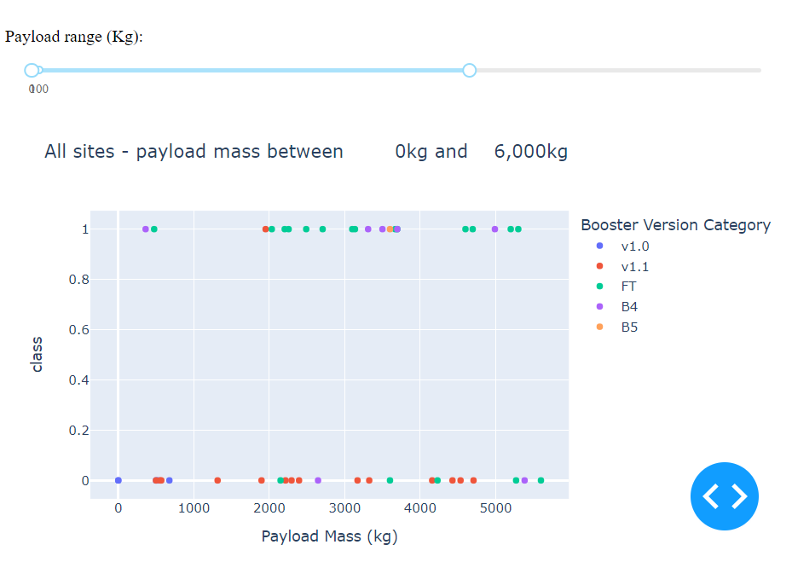
Payload and Launch Outcome
After some filtering and drill downs it is clear that the combination of payload under 6000Kg and FT boosters delivers the best combination for successful attempts.

Slide 45

Section 5

Slide 46
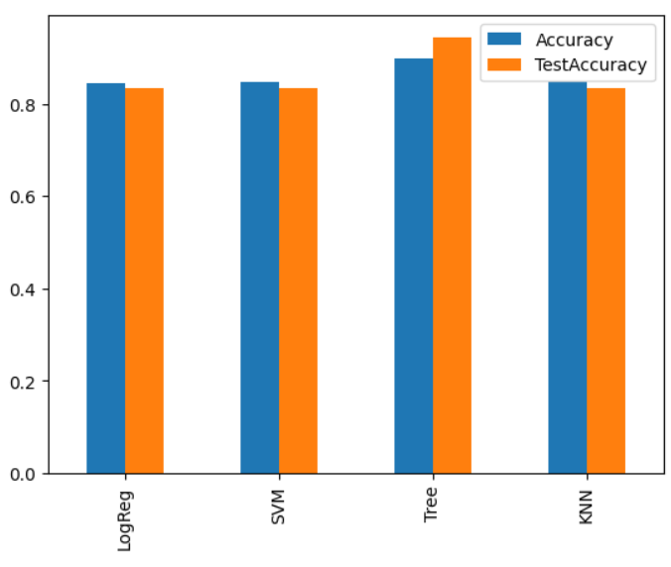
Classification Accuracy
On the right we can see accuracies for the classification models deployed
Decision Tree Classifier has performed better than other models with accuracies over 87%

Slide 47
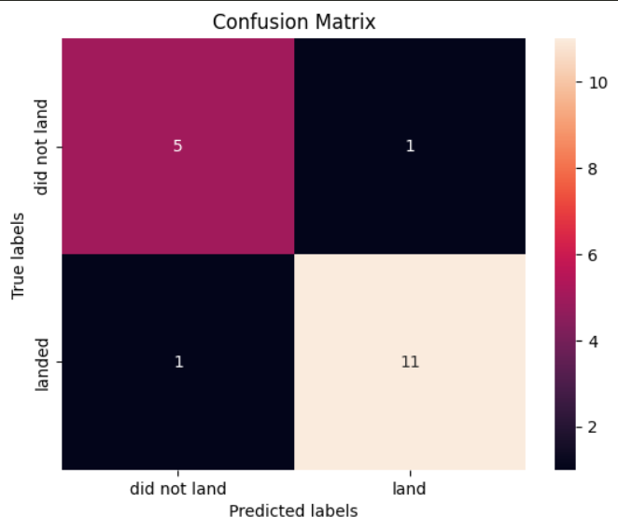
Confusion Matrix
Confusion matrix for the best model
TRUE POSITIVE
The model predicted correctly 11 successful attempts on 12 total successful attempts
TRUE NEGATIVE
The model predicted correctly 5 failures on 6 total failures
FALSE POSITIVE
1 failure has been incorrectly classified as successful attempt
FALSE NEGATIVE
1 successful attempt has been incorrectly classified as failure

Slide 48
Conclusions
The best launch site is KSC LC-39A, followed by CCAFS SLC 40
Launches with payloads over 7000Kg has higher success rate
To reach successful mission it takes approximately 3 years of tests and to reach first successful landing it takes approximately 5 years from start. After this period the success rate increases.
VLEO orbit launches seems to be a new market opportunity with improvement margins
The classification model can be useful to predict successful landings in order to estimate costs.

Slide 49
Appendix
Folium maps are not available when opening notebook on GitHub, please consider to download them.

Slide 50


